Slide 1

HEALTHCARE ANALYSIS
GROUP 6:
Devaiah
Husefa
Neha
Santhosh
Vinishia

Slide 2
INDEX
Sl. No. | TOPICS | SLIDE NO
1. | KPI 1 – Total Discharges | 3
2. | KPI 2 - Patient Days | 4
3. | KPI 3 - Net Patient Revenue | 5
4. | KPI 4 - Revenue Trend | 6
5. | KPI 5 – State-wise Hospitals and Revenue | 7
6. | KPI 6 – Revenue by Type of Hospital | 8
7. | KPI 7 - QTD and YTD Revenue | 9
8. | KPI 8 - Total Patients and Hospitals | 10
9. | MySQL Queries | 11
10. | Excel Dashboard | 12
11. | Power BI Dashboard | 13
12. | Tableau Dashboard | 14
13. | Inference Analysis | 15
14. | Challenges and Solutions | 16

Slide 3
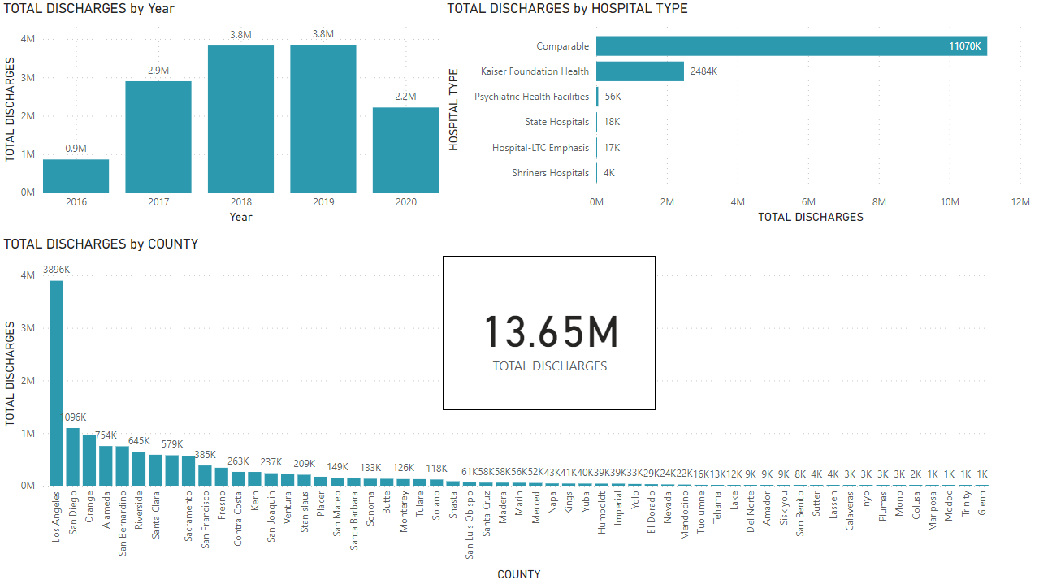
Total Discharges
﻿ Total Discharges Trend:
2016: 0.9M, 2019 peak: 3.8M, 2020: 2.2M (likely impacted by COVID-19).
Top Hospital Types:
Comparable Hospitals: 11.07M discharges.
Kaiser Foundation Health: 2.484M.
Other specialized facilities had fewer discharges (e.g., Psychiatric: 56K).
County Discharges:
Los Angeles: 3.896M (highest).
San Diego: 1.096M, Orange County: 754K.
Disparities across counties, with many below 100K.
Overall Total: 13.65M discharges

Slide 4
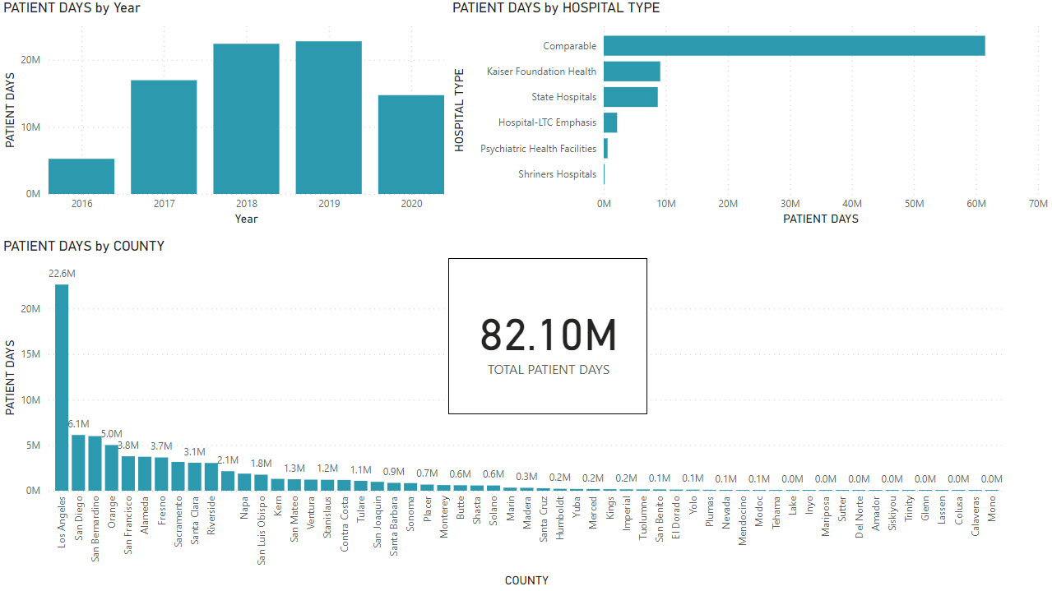
Patient Days
Total Patient Days:
82.10 million across all facilities.
Annual Trends:
Steady increase in Patient Days from 2016 to 2020, peaking in 2019.
County Distribution:
Los Angeles leads with 22.6 million, followed by San Diego (6.1 million) and San Bernardino (5 million).
Hospital Type Contributions:
Majority of Patient Days attributed to Comparable hospitals and Kaiser Foundation Health.

Slide 5
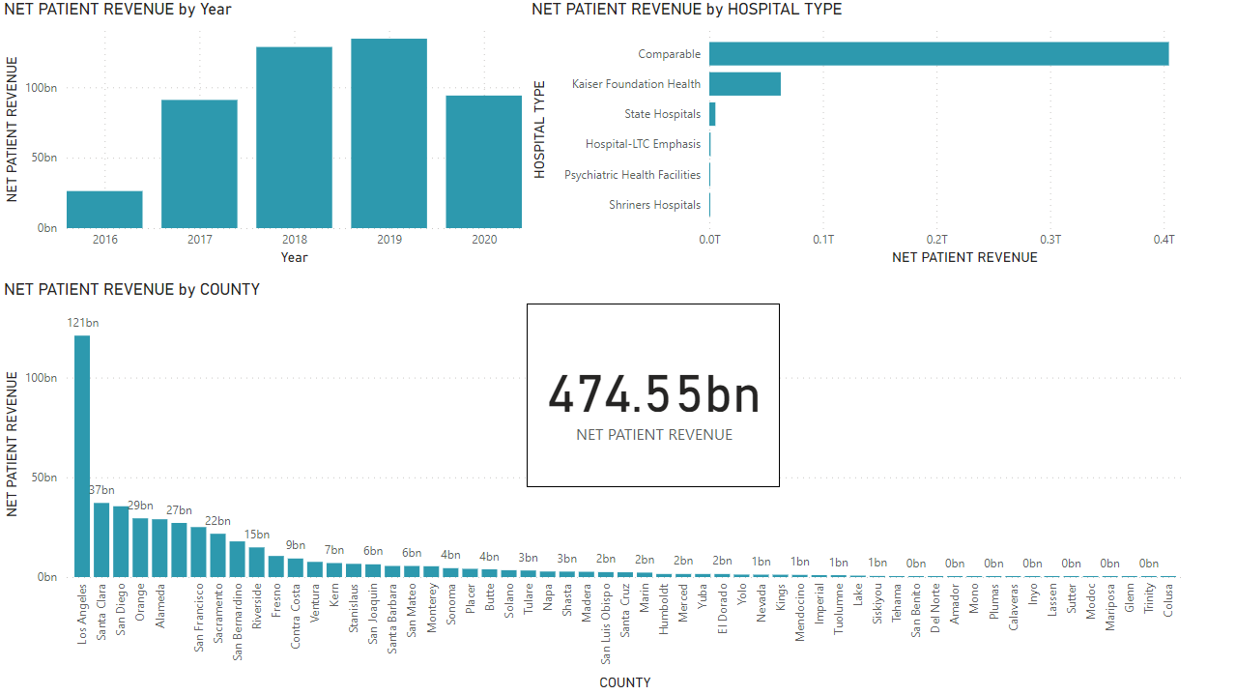
Net Patient Revenue
Total Revenue:
The overall Net Patient Revenue summed up to 474.55 billion.
Revenue Trends by Year:
2016-2020: Steady increase in revenue each year, indicating consistent growth and financial improvement.
County Comparison:
Los Angeles leads with the highest revenue at 121 billion.
Other notable counties include San Diego (37 billion) and Santa Clara (29 billion), showing significant disparities in revenue distribution.
Hospital Type Revenue:
Kaiser Foundation Health and Comparable hospital types contributed significantly to the overall revenue, suggesting a dominance in service provision.

Slide 6
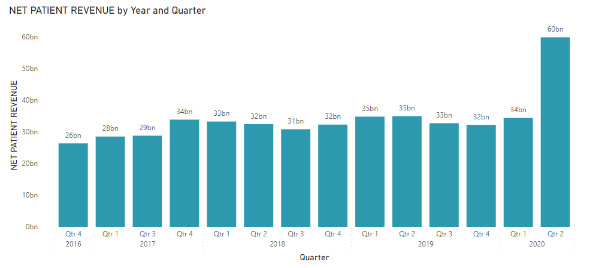
Revenue Trend
Overall Growth Trend:
Net Patient Revenue showed an upward trend from 2016 to 2020, indicating improved financial performance.
Yearly Summary:
2016: Revenue started at 26 billion in Q4.
2017: Fluctuated between 28 billion and 34 billion, peaking at 34 billion in Q4.
2018: Maintained levels around 32 billion to 33 billion, with a high of 33 billion in Q1.
2019: Consistent performance with peaks at 35 billion in Q1 and Q2.
2020: Notable spike to 60 billion in Q2, a substantial increase compared to prior quarters.
Quarterly Variations:
Fluctuations observed, especially with high revenue in Q4 across all years.
Impact of 2020:
The jump in Q2 2020 may indicate increased patient services or strategic financial measures during the pandemic.
Comparative Performance:
The revenue in Q2 2020 significantly surpassed all previous quarters, suggesting a notable anomaly or positive strategic change.

Slide 7
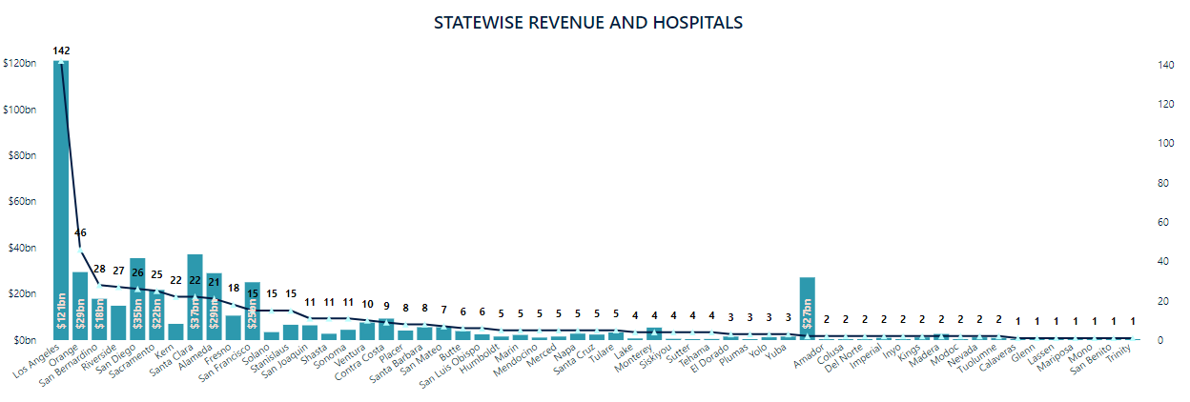
State-wise Hospitals and Revenue
Los Angeles Dominates:
Revenue: $121 billion
Hospitals: 142 (highest in the state)
Other High-Revenue Counties:
San Diego: $35 billion, 26 hospitals
San Bernardino: $18 billion, 28 hospitals
Revenue Outlier:
Amador: $27 billion with only 2 hospitals
General Trend:
Revenue and hospital numbers decrease sharply after Los Angeles.

Slide 8
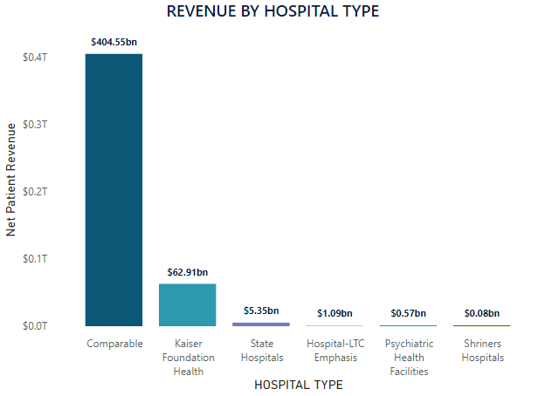
Revenue by Hospital Type
Comparable Hospitals Lead Revenue:
Revenue: $404.55 billion (highest)
This hospital type dominates net patient revenue.
Kaiser Foundation Health:
Revenue: $62.91 billion
Second-largest revenue generator, but significantly lower than comparable hospitals.
Smaller Revenue Generators:
State Hospitals: $5.35 billion
Hospital-LTC Emphasis: $1.09 billion
Psychiatric Health Facilities: $0.57 billion
Shriners Hospitals: $0.08 billion (smallest revenue).
Major Disparity in Revenue:
The gap between comparable hospitals and others is substantial, with comparable hospitals generating over 6x more revenue than Kaiser Foundation Health.

Slide 9
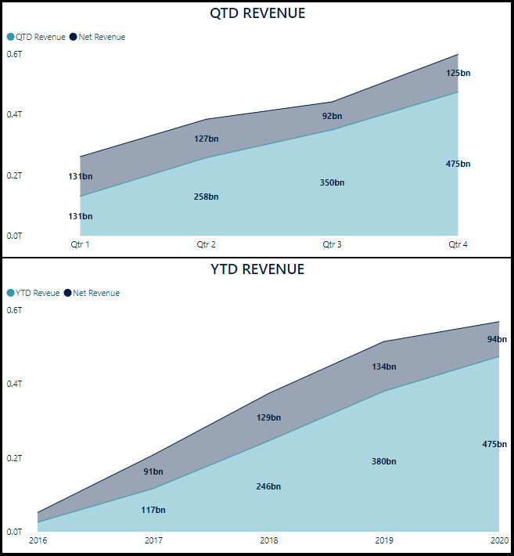
QTD and YTD Revenue
Steady QTD Growth:
Quarter 1: $131bn (Net & QTD)
Quarter 4: $475bn
Significant growth throughout the year, especially in Q3 and Q4
Consistent YTD Growth:
2016: $91bn → 2020: $475bn
Steady year-over-year growth, with a major increase from 2018 onwards.
Key Trend:
Both QTD and YTD revenues show consistent positive growth, with the highest revenue spikes occurring in Q4 of each year.

Slide 10

Total Patients and Hospitals
Patient Visits & Hospitals by Year (2016-2020):
Steady growth in patient visits from 13M (2016) to 61M (2019), but a decline to 33M in 2020.
Hospital count slightly fluctuated, with 511 hospitals in 2017 and a dip to 434 in 2020.
Hospital Type Insights:
Comparable Hospitals handle the largest share of patient visits (173.88M) across 494 hospitals.
Kaiser Foundation Health follows with 37.97M visits across 38 hospitals.
Other hospital types (e.g., LTC, Shriners, Psychiatric) have very few visits and hospitals.
County Breakdown:
Los Angeles leads with 44.09M visits across 142 hospitals.
San Diego and Santa Clara are the next largest contributors, with 14.55M and 11.51M visits, respectively.
Smaller counties show fewer patient visits and lower hospital counts.
Overall Totals:
212.22M total patient visits across 603 hospitals.

Slide 11
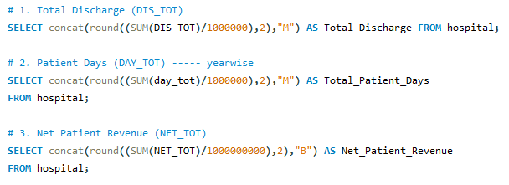

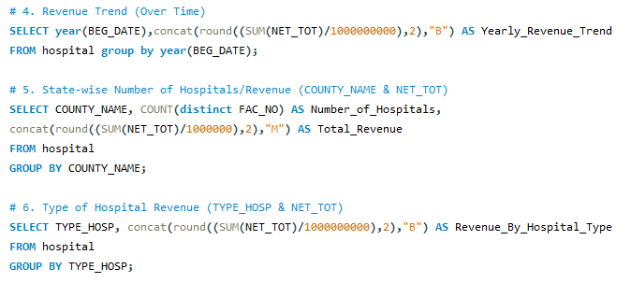
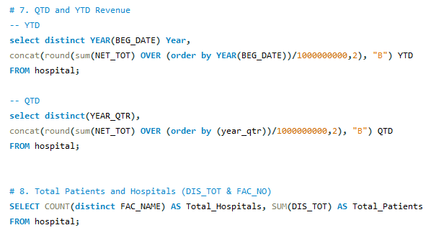
MySQL QUERIES

Slide 12
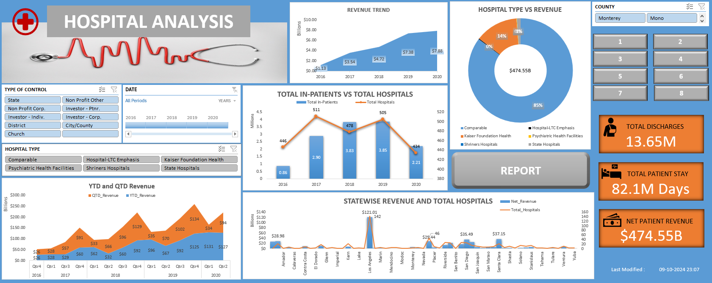
EXCEL DASHBOARD

Slide 13
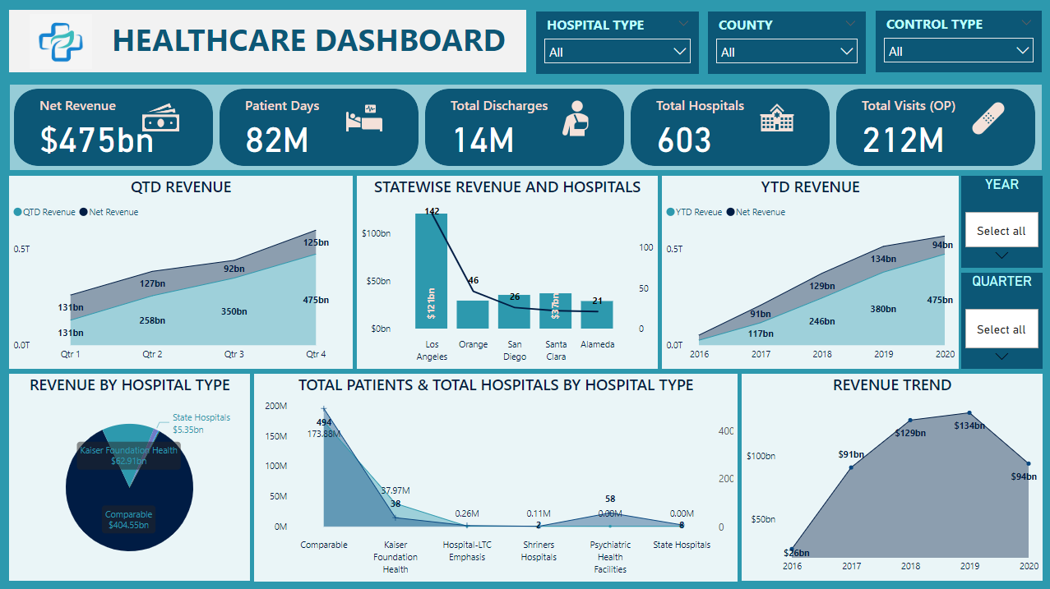
POWER BI DASHBOARD

Slide 14
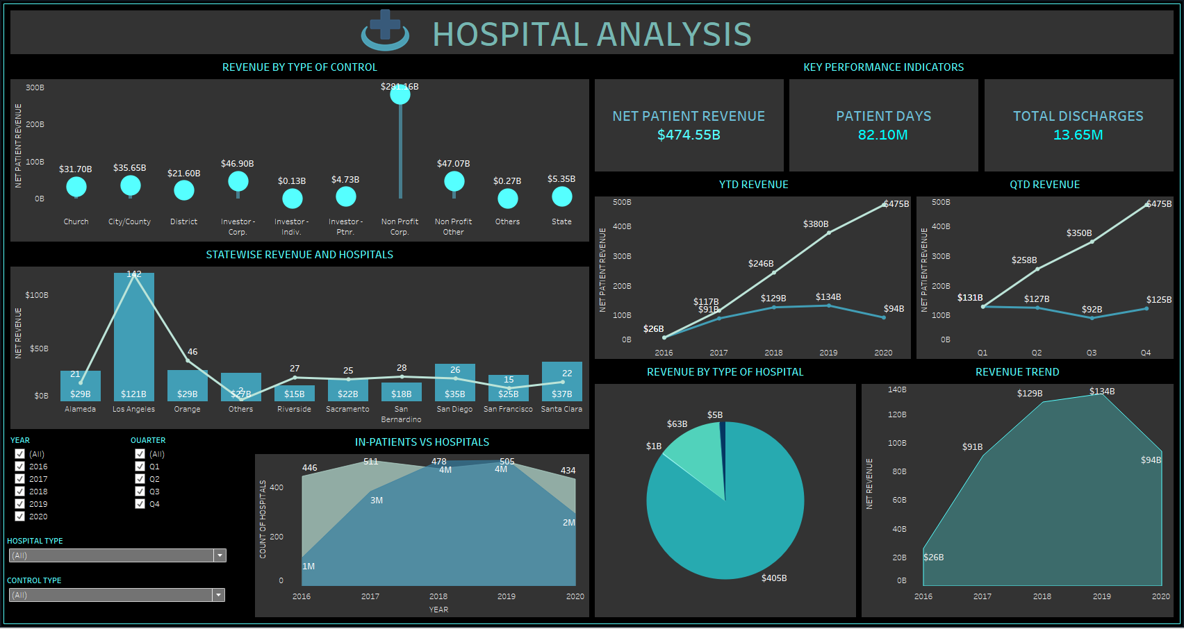
TABLEAU DASHBOARD

Slide 15
INFERENCE ANALYSIS
Discharges & Patient Days:
Significant growth in discharges from 2016 (0.9M) to 2019 (3.8M), followed by a decline in 2020 (2.2M), likely due to COVID-19.
82.10M Patient Days across all facilities, peaking in 2019.
Hospital Types & Revenue:
Comparable Hospitals dominate both discharges (11.07M) and revenue ($404.55B).
Kaiser Foundation Health follows with 2.484M discharges and $62.91B revenue.
Specialized hospitals (e.g., Psychiatric) contribute fewer discharges and revenue, showing a need for more focus on specialized care.
County Disparities:
Los Angeles leads with 3.896M discharges, 22.6M Patient Days, and $112B revenue.
Smaller counties have significant disparities in healthcare access and revenue generation.
Revenue Trends:
Consistent growth from $26B in 2016 to $60B in Q2 2020.
Q4 consistently shows revenue spikes, with a Q2 2020 surge due to the pandemic.
Improvements:
Expand telemedicine to maintain patient volumes in crises.
Address regional disparities by improving healthcare access in underserved counties.
Leverage specialized care and optimize smaller hospital contributions.

Slide 16
CHALLENGES AND SOLUTIONS
Challenges:
Understanding Data: Short forms in the headers made it difficult to comprehend the data.
Too Many Columns (113): The large number of columns caused slowness and lag during analysis.
Compiling 15 CSV Files: Some files were corrupted, leading to errors and delays in loading the data.
Too Many States in Dashboard: Displaying all states cluttered the dashboard, making analysis challenging.
Solutions:
Data Clarification: Used ChatGPT to define and understand the short forms in the headers, simplifying data interpretation.
Column Reduction: After reviewing the data, unnecessary columns were removed to enhance performance and reduce lag.
File Recovery: New copies of the corrupted CSV files were created and successfully loaded.
Top-n Parameter: Implemented a Top-n parameter to limit the number of states displayed in the dashboard for better clarity.

Slide 17


